Slide 1
Chapter 1: Diodes and Applications
Module – 2 : Applications of Diodes
Reference: Robert L. Boylestad, Louis Nashelsky, Electronic Devices & Circuits Theory, 11th Edition, PHI, 2012

Slide 2
At the end of this module, students will be able to:
Explain need for AC to DC conversion
Discuss basic DC power supply unit.
Discuss and analyze the working of a various rectifier circuits.
Explain how capacitor filter can be used to minimize the ac component.

Slide 3
Rectifiers
Circuit that converts AC to DC
Half wave rectifier
Full wave rectifier →
Centre tapped full wave rectifier
Full wave bridge rectifier
Rectifiers with capacitor filter

Slide 4
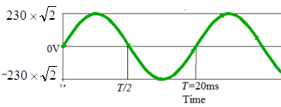
What is an AC and an DC signal?
Example of AC signal
Define
Average value
RMS or effective value
Electricity distribution in INDIA: AC signal of 230V, 50HZ.
Necessity of DC power: Many electronic gadgets
AC signal with A=230V, f=50Hz
Note: The average or DC value of this signal is equal to zero.

Slide 5
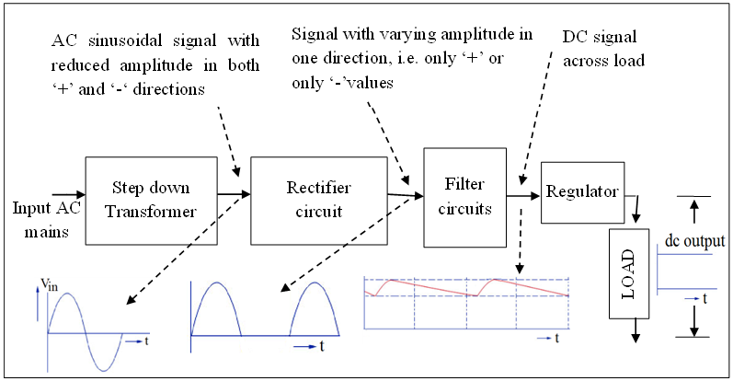
Block diagram of a DC power supply

Slide 6
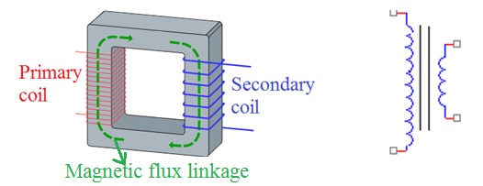
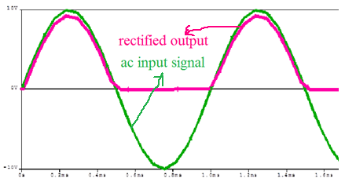
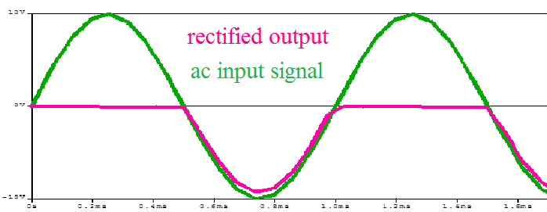
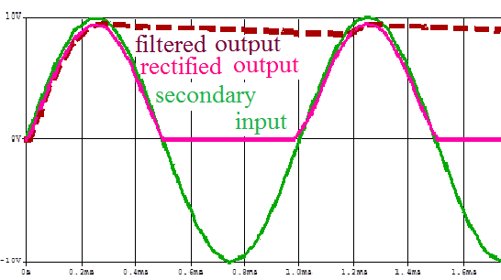
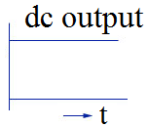
Steps of conversion
Step down transformer
Rectified output w.r.t. transformer output
Filtered output
Regulator output (Pure DC)
Notes:
Rectifiers converts an ac sinusoidal signal that is bidirectional with positive and negative amplitudes into a signal with only unidirectional amplitudes that is only positive or only negative. Thus rectifier circuit forces the current through the load to flow in only in one direction. The out put of rectifier is called pulsating dc signal.
A filter circuit filters ac content from pulsating dc. A filter has to have a capacitor, an energy storing component that can hold the voltage to the peak value of the rectified pulsating dc and then dissipate energy to load when the pulsating dc drops.
Finally regulator is used to provide constant dc voltage despite of variations in the mains ac power supply or load variations.

Slide 7
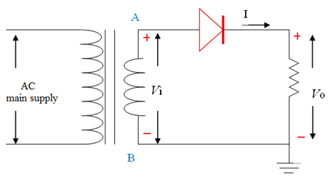
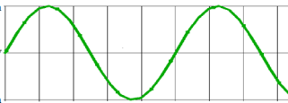

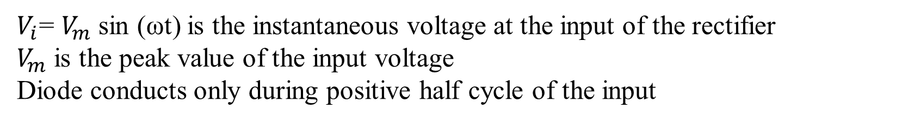
Half wave rectifier
$V_{i}$= $V_{m}$ sin (ωt) is the instantaneous voltage at the input of the rectifier
$V_{m}$ is the peak value of the input voltage
Diode conducts only during positive half cycle of the input

Slide 8
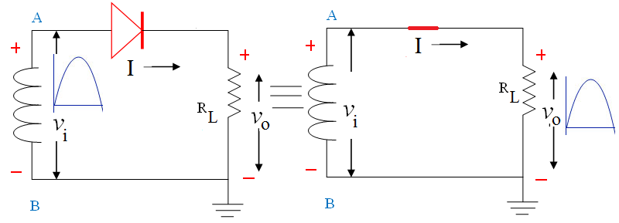
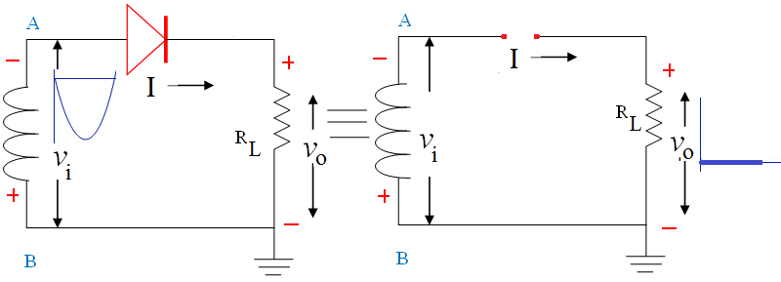
Working of HWR
Equivalent Circuit of HWR, when node A is positive w.r.t node B
Equivalent Circuit of HWR, when node A is negative w.r.t node B
Note: Current through load exist only for one half cycle

Slide 9
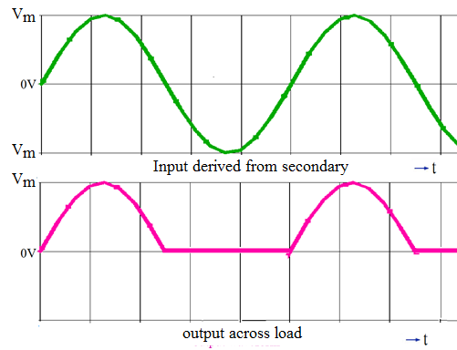
HWR Waveforms

Slide 10

Performance parameters of HWR
Assume ideal diode :
$V_{ϒ}$= 0 ; $R_{F}$=0
During positive half cycle, $I$= $I_{m}$sin (ωt)
Where $I_{m}$ is the peak value of the input current
$I_{m}$=$\frac{V_{m}−V_{ϒ}}{R_{L}+R_{F}}$ ≃ $\frac{V_{m}}{R_{L}}$

Slide 11

Average/DC value of load current ($I_{dc}$)
$I_{dc}$=$\frac{1}{2π}\int_{0}^{2π}{I }$d(ωt)
= $\frac{1}{2π}\int_{0}^{π}{I_{m}}$sin (ωt)d(ωt)
= $\frac{−I_{m}}{2π}$ ${\left[cos⁡(\text{ω}\text{t})\right]}_{0}^{π}$
$I_{dc}$= $\frac{I_{m}}{π}$

Slide 12

Average/DC voltage across the load ($V_{dc}$)
$V_{dc}$= $I_{dc}$* $R_{L}$
= $\frac{I_{m}}{π}$ * $R_{L}$
= $\frac{V_{m}}{R_{L}∗π}$ * $R_{L}$
$V_{dc}$ = $\frac{V_{m}}{π}$

Slide 13
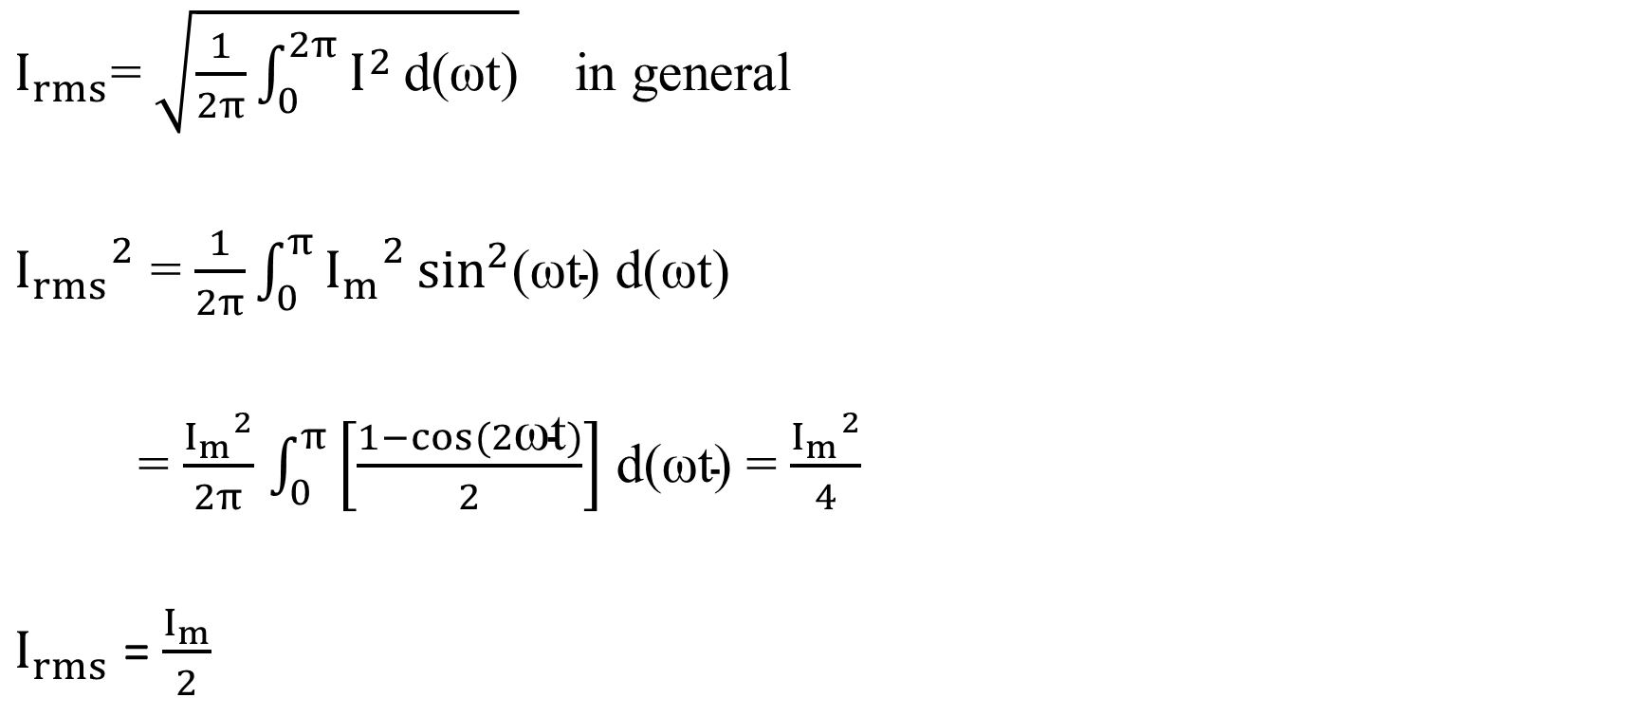
RMS value of load current ($I_{rms}$)
$I_{rms}$=$\sqrt{\frac{1}{2π}\int_{0}^{2π}{I^{2}}\text{d}\text{(}\text{ω}\text{t}\text{)}}$ in general
${I_{rms}}^{2}$ = $\frac{1}{2π}\int_{0}^{π}{{I_{m}}^{2}}\sin^{2}\text{(}\text{ω}\text{t}\text{) }\text{d}\text{(}\text{ω}\text{t}\text{)}$
= $\frac{{I_{m}}^{2}}{2π}$ $\int_{0}^{π}{\left[\frac{1−cos(2\text{ω}\text{t})}{2}\right]}$ $\text{d}\text{(}\text{ω}\text{t}\text{)}$ = $\frac{{I_{m}}^{2}}{4}$
$I_{rms}$ =$\frac{I_{m}}{2}$

Slide 14


RMS value of the load voltage ($V_{rms}$)
$V_{rms}$= $I_{rms}$* $R_{L}$
= $\frac{I_{m}}{2}$ * $R_{L}$
= $\frac{V_{m}}{R_{L}∗2}$ * $R_{L}$
$V_{rms}$ = $\frac{V_{m}}{2}$

Slide 15
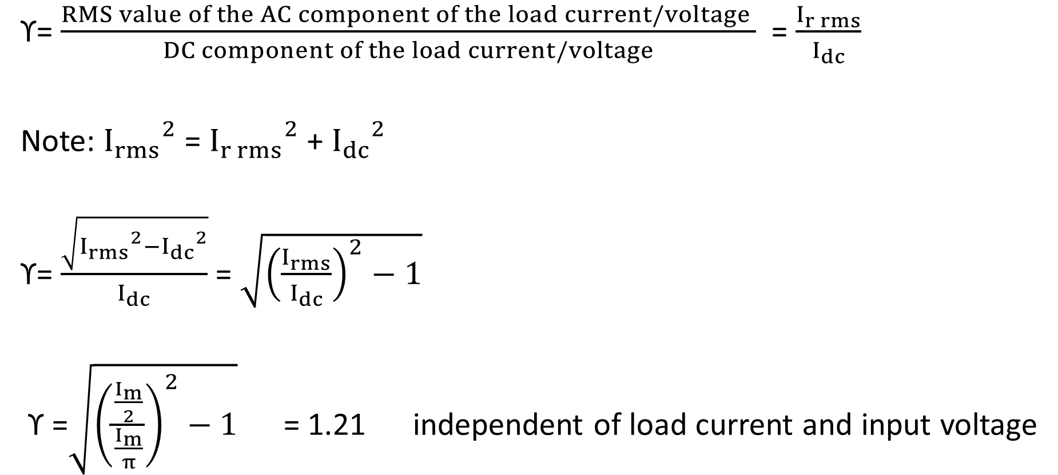
Ripple factor (ϒ)
ϒ= $\frac{RMS value of the AC component of the load current/voltage }{DC component of the load current/voltage}$ = $\frac{I_{r rms}}{I_{dc}}$
Note: ${I_{rms}}^{2}$ = ${I_{r rms}}^{2}$ + ${I_{dc}}^{2}$
ϒ= $\frac{\sqrt{{I_{rms}}^{2}−{I_{dc}}^{2}}}{I_{dc}}$ = $\sqrt{{\left(\frac{I_{rms}}{I_{dc}}\right)}^{2}−1}$
ϒ =$\sqrt{{\left(\frac{\frac{I_{m}}{2}}{\frac{I_{m}}{π}}\right)}^{2}−1}$ = 1.21 independent of load current and input voltage

Slide 16
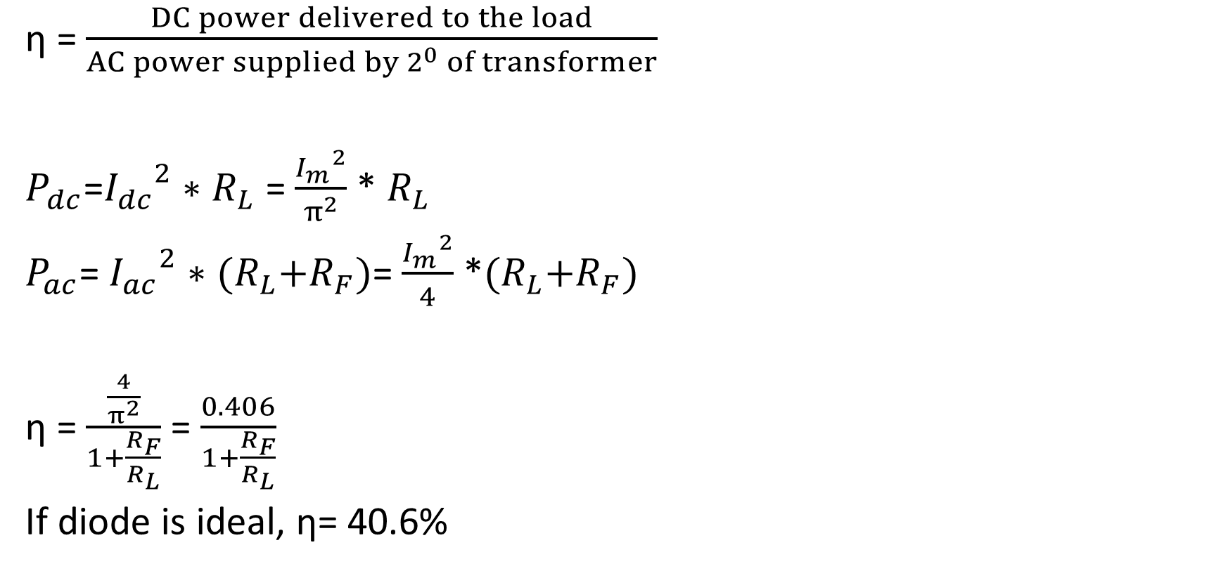
Efficiency (η)
η = $\frac{DC power delivered to the load}{AC power supplied by 2^{0} of transformer}$
$P_{dc}$=${I_{dc}}^{2}∗$ $R_{L}$ = $\frac{{I_{m}}^{2}}{π^{2}}$ * $R_{L}$
$P_{ac}$= ${I_{ac}}^{2}∗$ ${(R}_{L}+R_{F})$= $\frac{{I_{m}}^{2}}{4}$ *${(R}_{L}+R_{F})$
η = $\frac{\frac{4}{π^{2}}}{1+\frac{R_{F}}{R_{L}}}$ = $\frac{0.406}{1+\frac{R_{F}}{R_{L}}}$
If diode is ideal, η= 40.6%

Slide 17

Peak Inverse Voltage(PIV)
Maximum reverse voltage beyond which the diode breaks down.
Choose a diode with PIV> $V_{m}$

Slide 18
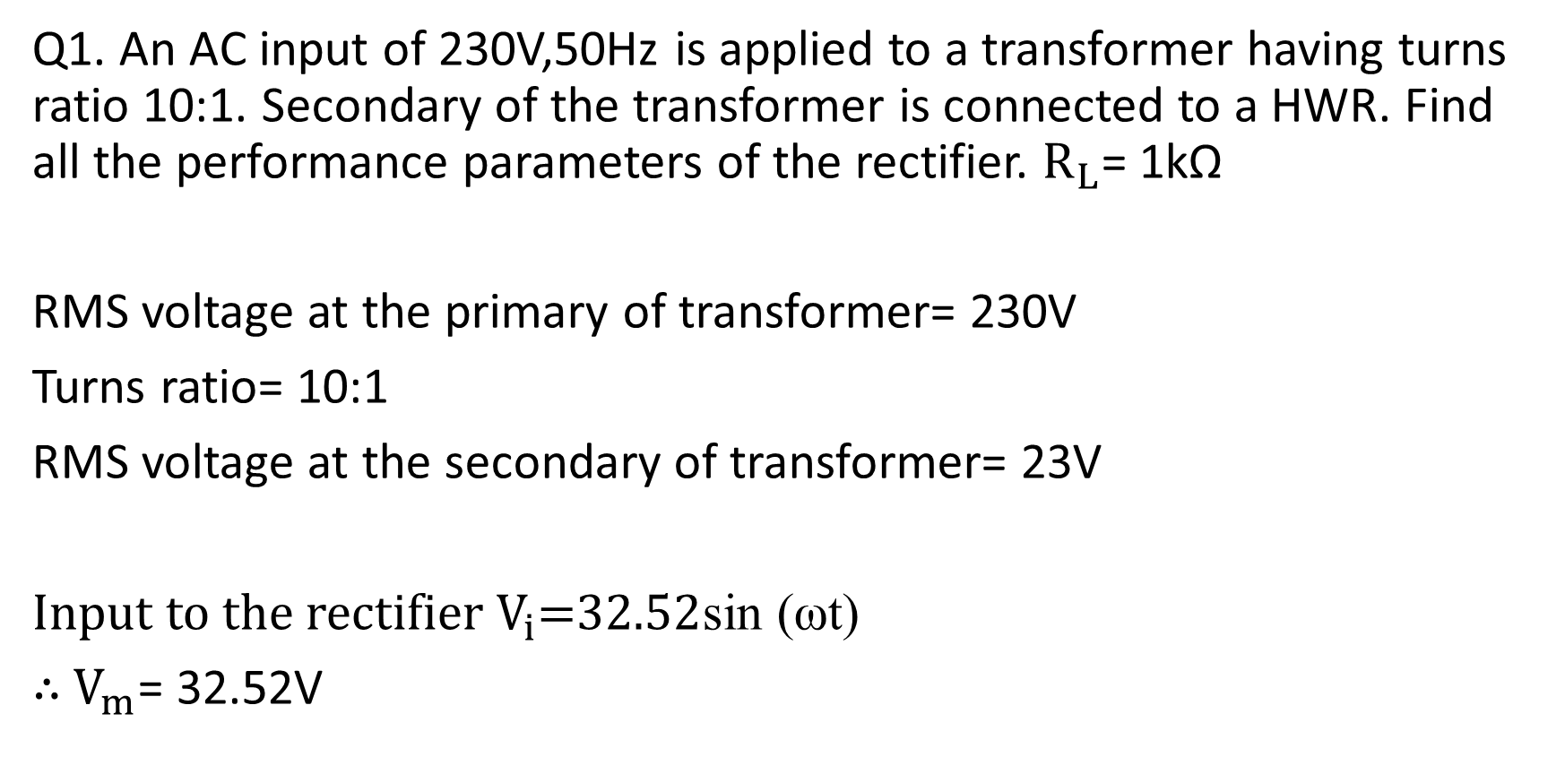
Q1. An AC input of 230V,50Hz is applied to a transformer having turns ratio 10:1. Secondary of the transformer is connected to a HWR. Find all the performance parameters of the rectifier. $R_{L}$= 1kΩ
RMS voltage at the primary of transformer= 230V
Turns ratio= 10:1
RMS voltage at the secondary of transformer= 23V
Input to the rectifier $V_{i}$=$32.52$sin (ωt)
$∴$ $V_{m}$= 32.52V

Slide 19
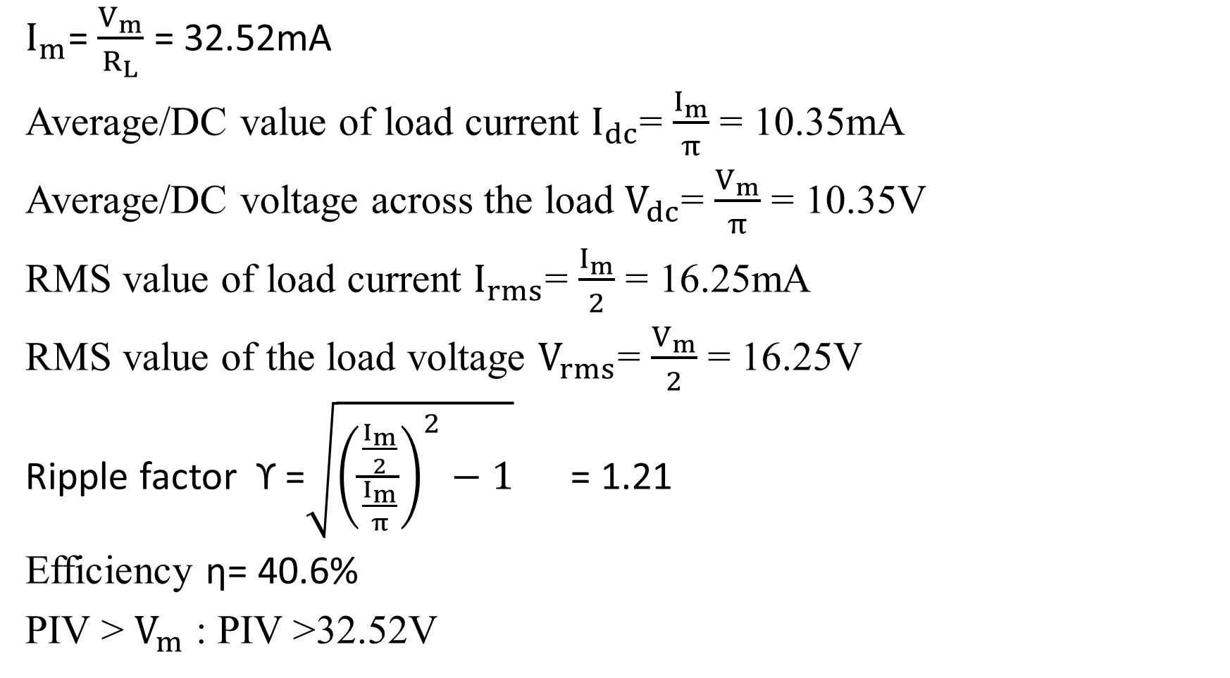
$I_{m}$= $\frac{V_{m}}{R_{L}}$ = 32.52mA
Average/DC value of load current $I_{dc}$= $\frac{I_{m}}{π}$ = 10.35mA
Average/DC voltage across the load $V_{dc}$= $\frac{V_{m}}{π}$ = 10.35V
RMS value of load current $I_{rms}$= $\frac{I_{m}}{2}$ = 16.25mA
RMS value of the load voltage $V_{rms}$= $\frac{V_{m}}{2}$ = 16.25V
Ripple factor ϒ =$\sqrt{{\left(\frac{\frac{I_{m}}{2}}{\frac{I_{m}}{π}}\right)}^{2}−1}$ = 1.21
Efficiency η= 40.6%
PIV > $V_{m}$ : PIV >32.52V

Slide 20
Q2. A sinusoidal voltage of peak value 10V is applied to a HWR. If the load resistance is 800Ω, calculate all the performance parameters of the rectifier.

Slide 21
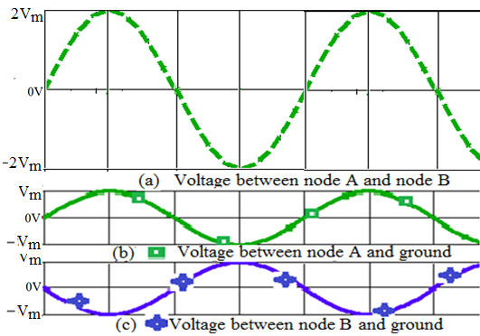
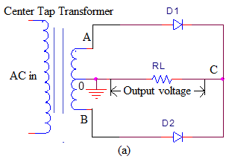
Full Wave Rectifier with centre tapped transformer

Slide 22
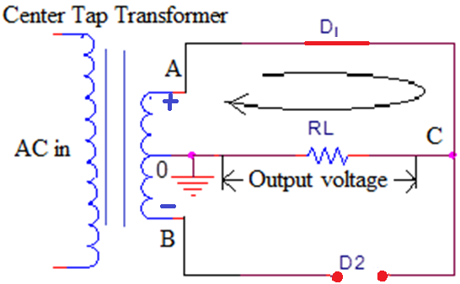
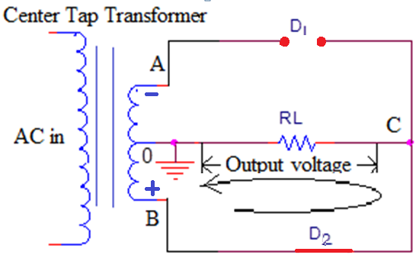
Working of Full Wave Rectifier
Center tapped FWR for Center tapped FWR for node A is positive w.r.t B node B is positive w.r.t A

Slide 23
Note: Current through load during both cycles is in same direction (from node C to ground)
The frequency of the output signal =Twice the input frequency

Slide 24
FWR Waveforms

Slide 25

Performance parameters of FWR
Assume ideal diode :
$V_{ϒ}$= 0 ; $R_{F}$=0
During positive half cycle, $I$= $I_{m}$sin (ωt)
Where $I_{m}$ is the peak value of the input current
$I_{m}$=$\frac{V_{m}−V_{ϒ}}{R_{L}+R_{F}}$ = $\frac{V_{m}}{R_{L}}$

Slide 26

Average/DC value of load current ($I_{dc}$)
$I_{dc}$=$\frac{1}{π}\int_{0}^{π}{I }$d(ωt)
= $\frac{1}{π}\int_{0}^{π}{I_{m}}$sin (ωt)d(ωt)
= $\frac{I_{m}}{π}$ ${\left[−cos⁡(\text{ω}\text{t})\right]}_{0}^{π}$
$I_{dc}$= $\frac{{2I}_{m}}{π}$

Slide 27

Average/DC voltage across the load ($V_{dc}$)
$V_{dc}$= $I_{dc}$* $R_{L}$
= $\frac{{2I}_{m}}{π}$ * $R_{L}$
= $\frac{{2V}_{m}}{R_{L}∗π}$ * $R_{L}$
$V_{dc}$ = $\frac{{2V}_{m}}{π}$

Slide 28
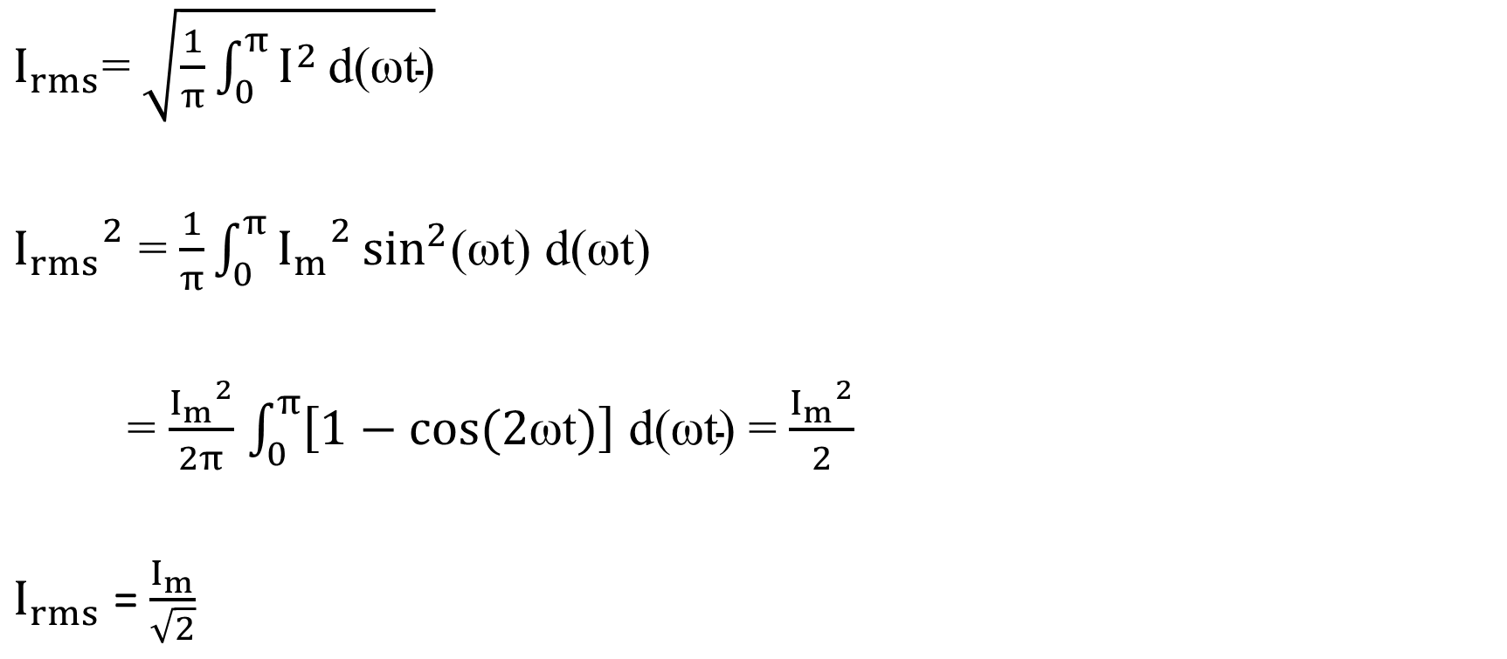
RMS value of load current ($I_{rms}$)
$I_{rms}$=$\sqrt{\frac{1}{π}\int_{0}^{π}{I^{2}}\text{d}\text{(}\text{ω}\text{t}\text{)}}$
${I_{rms}}^{2}$ = $\frac{1}{π}\int_{0}^{π}{{I_{m}}^{2}}\sin^{2}\text{(}\text{ω}\text{t}\text{) }\text{d}\text{(}\text{ω}\text{t}\text{)}$
= $\frac{{I_{m}}^{2}}{2π}$ $\int_{0}^{π}{\left[1−cos(2\text{ω}\text{t})\right]}$ $\text{d}\text{(}\text{ω}\text{t}\text{)}$ = $\frac{{I_{m}}^{2}}{2}$
$I_{rms}$ =$\frac{I_{m}}{\sqrt{2}}$

Slide 29

RMS value of the load voltage ($V_{rms}$)
$V_{rms}$= $I_{rms}$* $R_{L}$
=$\frac{I_{m}}{\sqrt{2}}$* $R_{L}$
= $\frac{V_{m}}{R_{L}∗\sqrt{2}}$ * $R_{L}$
$V_{rms}$ = $\frac{V_{m}}{\sqrt{2}}$

Slide 30
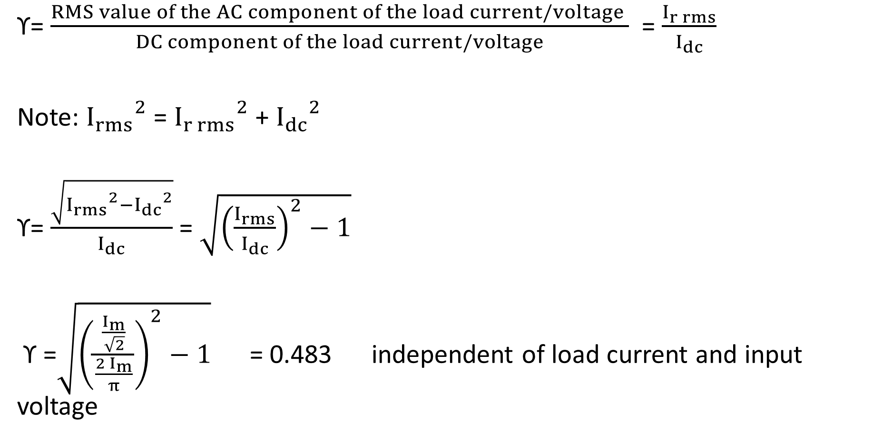
Ripple factor (ϒ)
ϒ= $\frac{RMS value of the AC component of the load current/voltage }{DC component of the load current/voltage}$ = $\frac{I_{r rms}}{I_{dc}}$
Note: ${I_{rms}}^{2}$ = ${I_{r rms}}^{2}$ + ${I_{dc}}^{2}$
ϒ= $\frac{\sqrt{{I_{rms}}^{2}−{I_{dc}}^{2}}}{I_{dc}}$ = $\sqrt{{\left(\frac{I_{rms}}{I_{dc}}\right)}^{2}−1}$
ϒ =$\sqrt{{\left(\frac{\frac{I_{m}}{\sqrt{2}}}{\frac{{2 I}_{m}}{π}}\right)}^{2}−1}$ = 0.483 independent of load current and input voltage

Slide 31
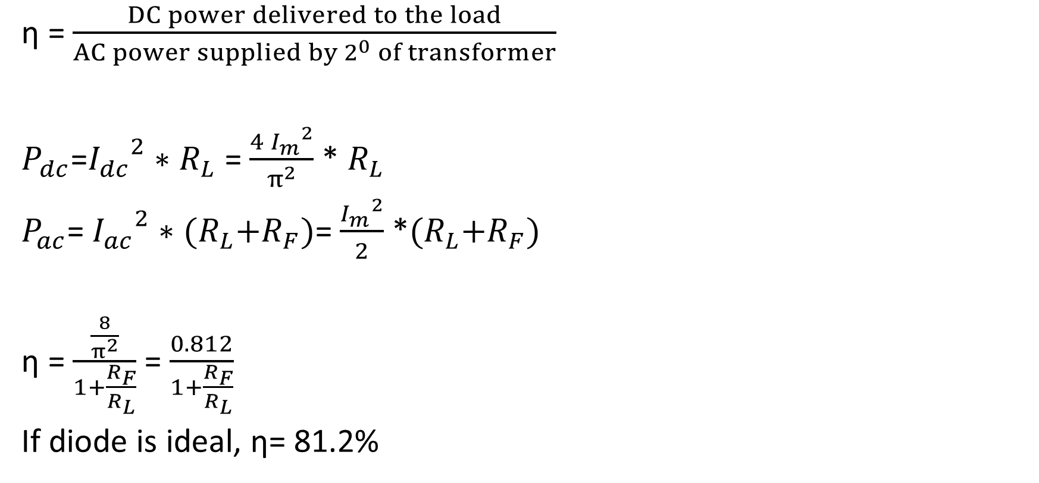
Efficiency (η)
η = $\frac{DC power delivered to the load}{AC power supplied by 2^{0} of transformer}$
$P_{dc}$=${I_{dc}}^{2}∗$ $R_{L}$ = $\frac{{{4 I}_{m}}^{2}}{π^{2}}$ * $R_{L}$
$P_{ac}$= ${I_{ac}}^{2}∗$ ${(R}_{L}+R_{F})$= $\frac{{I_{m}}^{2}}{2}$ *${(R}_{L}+R_{F})$
η = $\frac{\frac{8}{π^{2}}}{1+\frac{R_{F}}{R_{L}}}$ = $\frac{0.812}{1+\frac{R_{F}}{R_{L}}}$
If diode is ideal, η= 81.2%

Slide 32

Peak Inverse Voltage(PIV)
Maximum reverse voltage beyond which the diode breaks down.
Choose a diode with PIV> $2V_{m}$

Slide 33
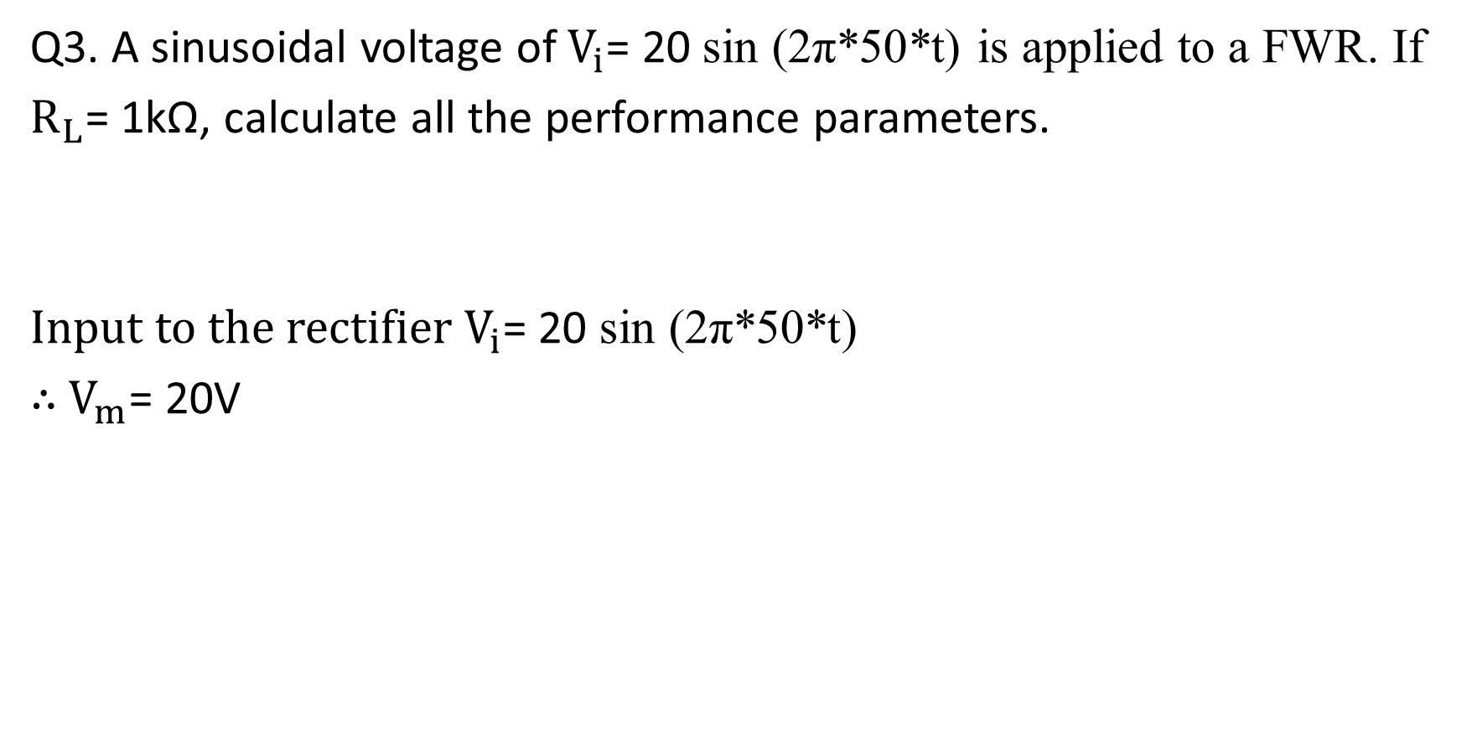
Q3. A sinusoidal voltage of $V_{i}$= 20 sin (2π*50*t) is applied to a FWR. If
$R_{L}$= 1kΩ, calculate all the performance parameters.
Input to the rectifier $V_{i}$= 20 sin (2π*50*t)
$∴$ $V_{m}$= 20V

Slide 34
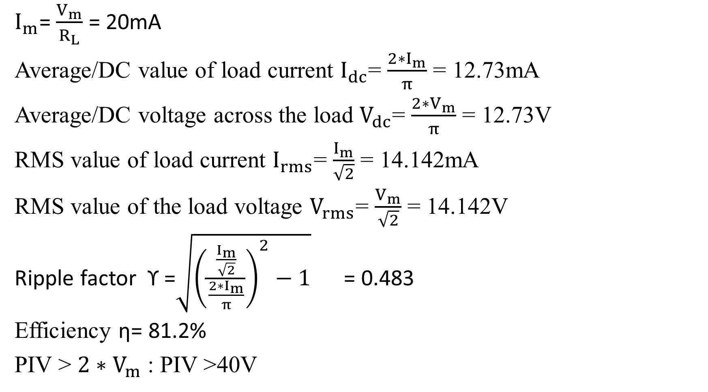
$I_{m}$= $\frac{V_{m}}{R_{L}}$ = 20mA
Average/DC value of load current $I_{dc}$= $\frac{2∗I_{m}}{π}$ = 12.73mA
Average/DC voltage across the load $V_{dc}$= $\frac{2∗V_{m}}{π}$ = 12.73V
RMS value of load current $I_{rms}$= $\frac{I_{m}}{\sqrt{2}}$ = 14.142mA
RMS value of the load voltage $V_{rms}$= $\frac{V_{m}}{\sqrt{2}}$ = 14.142V
Ripple factor ϒ =$\sqrt{{\left(\frac{\frac{I_{m}}{\sqrt{2}}}{\frac{2∗I_{m}}{π}}\right)}^{2}−1}$ = 0.483
Efficiency η= 81.2%
PIV > $2∗V_{m}$ : PIV >40V

Slide 35
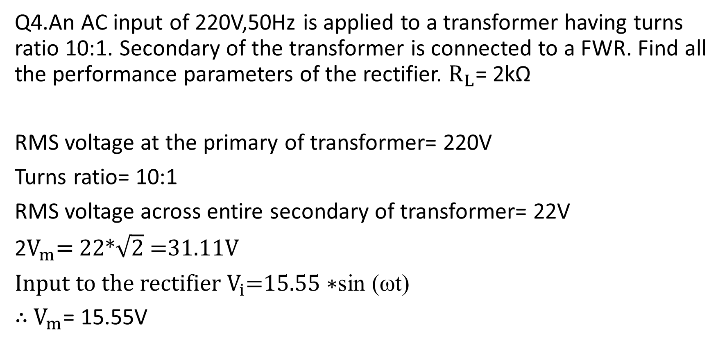
Q4.An AC input of 220V,50Hz is applied to a transformer having turns ratio 10:1. Secondary of the transformer is connected to a FWR. Find all the performance parameters of the rectifier. $R_{L}$= 2kΩ
RMS voltage at the primary of transformer= 220V
Turns ratio= 10:1
RMS voltage across entire secondary of transformer= 22V
2$V_{m}$= 22*$\sqrt{2}$ =31.11V
Input to the rectifier $V_{i}$=$15.55∗$sin (ωt)
$∴$ $V_{m}$= 15.55V

Slide 36
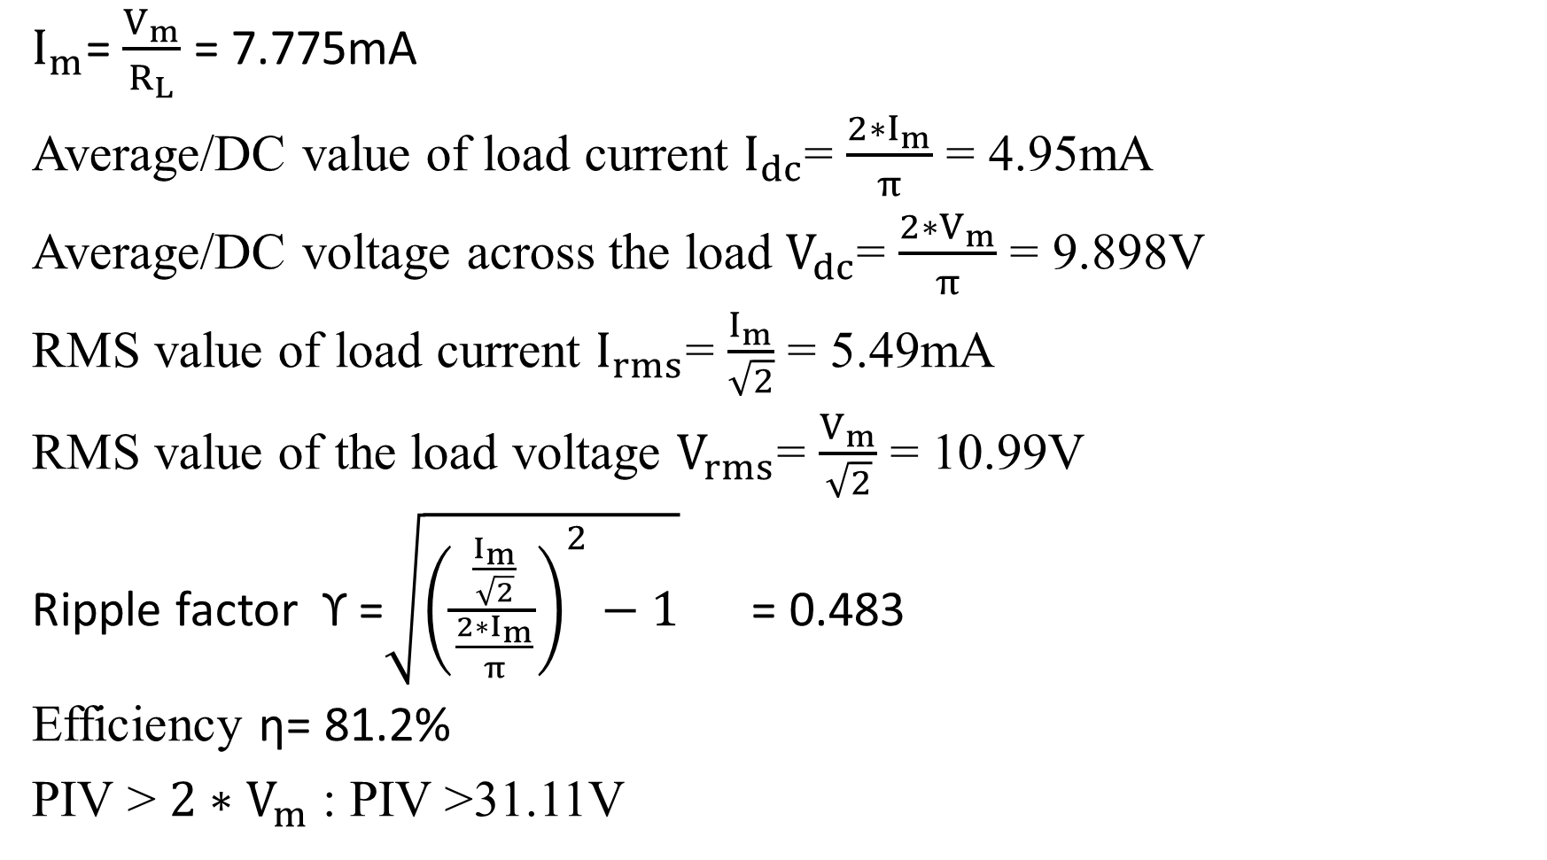
$I_{m}$= $\frac{V_{m}}{R_{L}}$ = 7.775mA
Average/DC value of load current $I_{dc}$= $\frac{2∗I_{m}}{π}$ = 4.95mA
Average/DC voltage across the load $V_{dc}$= $\frac{2∗V_{m}}{π}$ = 9.898V
RMS value of load current $I_{rms}$= $\frac{I_{m}}{\sqrt{2}}$ = 5.49mA
RMS value of the load voltage $V_{rms}$= $\frac{V_{m}}{\sqrt{2}}$ = 10.99V
Ripple factor ϒ =$\sqrt{{\left(\frac{\frac{I_{m}}{\sqrt{2}}}{\frac{2∗I_{m}}{π}}\right)}^{2}−1}$ = 0.483
Efficiency η= 81.2%
PIV > $2∗V_{m}$ : PIV >31.11V

Slide 37
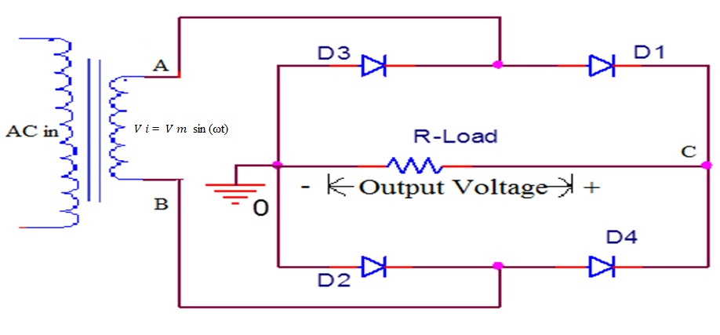
Full Wave Bridge Rectifier

Slide 38
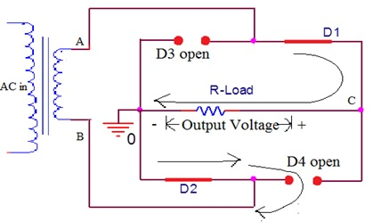
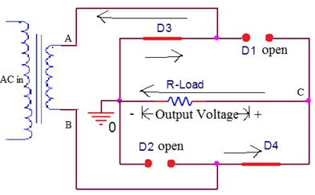
Working of Full Wave Bridge Rectifier
Bridge FWR when node A is Bridge FWR when node B is positive w.r.t B positive w.r.t. A
Note: Current through load for both cycles is in same direction
(from node C to ground)

Slide 39
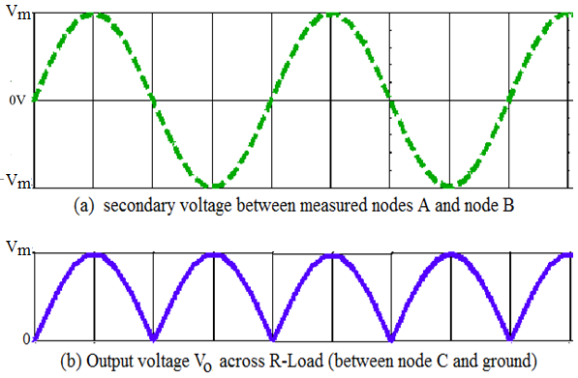
Bridge Rectifier Waveforms
Note: The frequency of the output signal =2 times the input frequency

Slide 40

Performance parameters of Full Wave Bridge Rectifier
Assume ideal diode :
$V_{ϒ}$= 0 ; $R_{F}$=0
During positive half cycle, $I$= $I_{m}$sin (ωt)
Where $I_{m}$ is the peak value of the input current
$I_{m}$=$\frac{V_{m}−{2V}_{ϒ}}{R_{L}+2R_{F}}$ = $\frac{V_{m}}{R_{L}}$

Slide 41
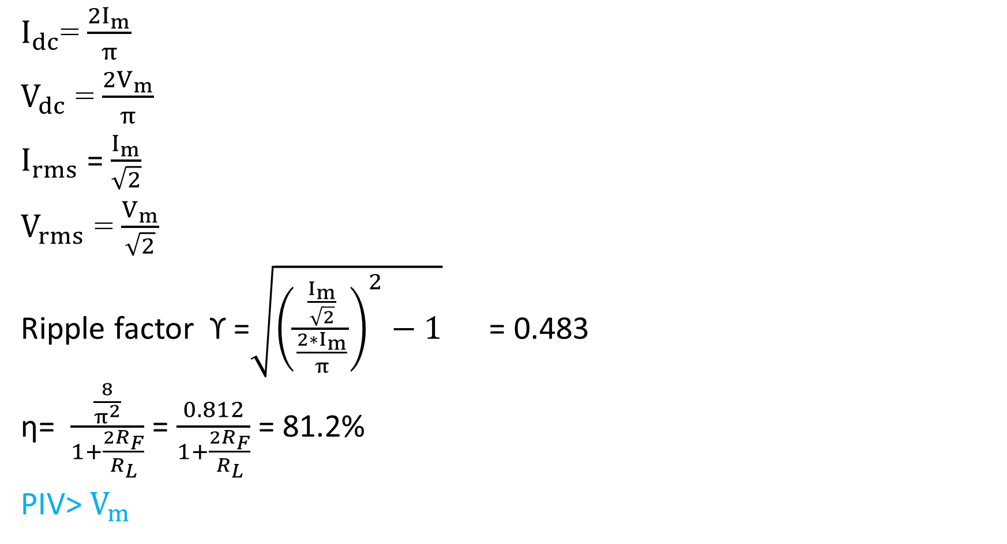
$I_{dc}$= $\frac{{2I}_{m}}{π}$
$V_{dc}$ = $\frac{{2V}_{m}}{π}$
$I_{rms}$ =$\frac{I_{m}}{\sqrt{2}}$
$V_{rms}$ = $\frac{V_{m}}{\sqrt{2}}$
Ripple factor ϒ =$\sqrt{{\left(\frac{\frac{I_{m}}{\sqrt{2}}}{\frac{2∗I_{m}}{π}}\right)}^{2}−1}$ = 0.483
η= $\frac{\frac{8}{π^{2}}}{1+\frac{{2R}_{F}}{R_{L}}}$ = $\frac{0.812}{1+\frac{{2R}_{F}}{R_{L}}}$ = 81.2%
PIV> $V_{m}$
Same as that of
Full Wave Rectifier

Slide 42
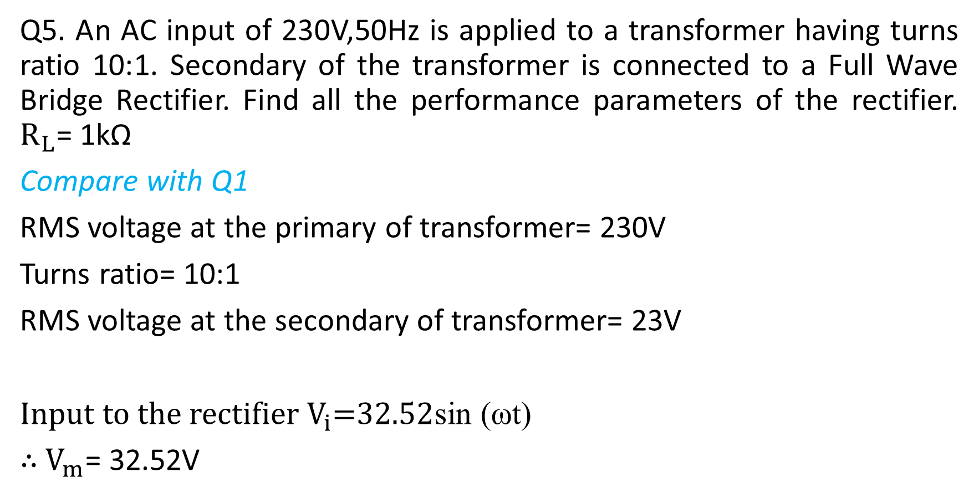
Q5. An AC input of 230V,50Hz is applied to a transformer having turns ratio 10:1. Secondary of the transformer is connected to a Full Wave Bridge Rectifier. Find all the performance parameters of the rectifier. $R_{L}$= 1kΩ
Compare with Q1
RMS voltage at the primary of transformer= 230V
Turns ratio= 10:1
RMS voltage at the secondary of transformer= 23V
Input to the rectifier $V_{i}$=$32.52$sin (ωt)
$∴$ $V_{m}$= 32.52V

Slide 43
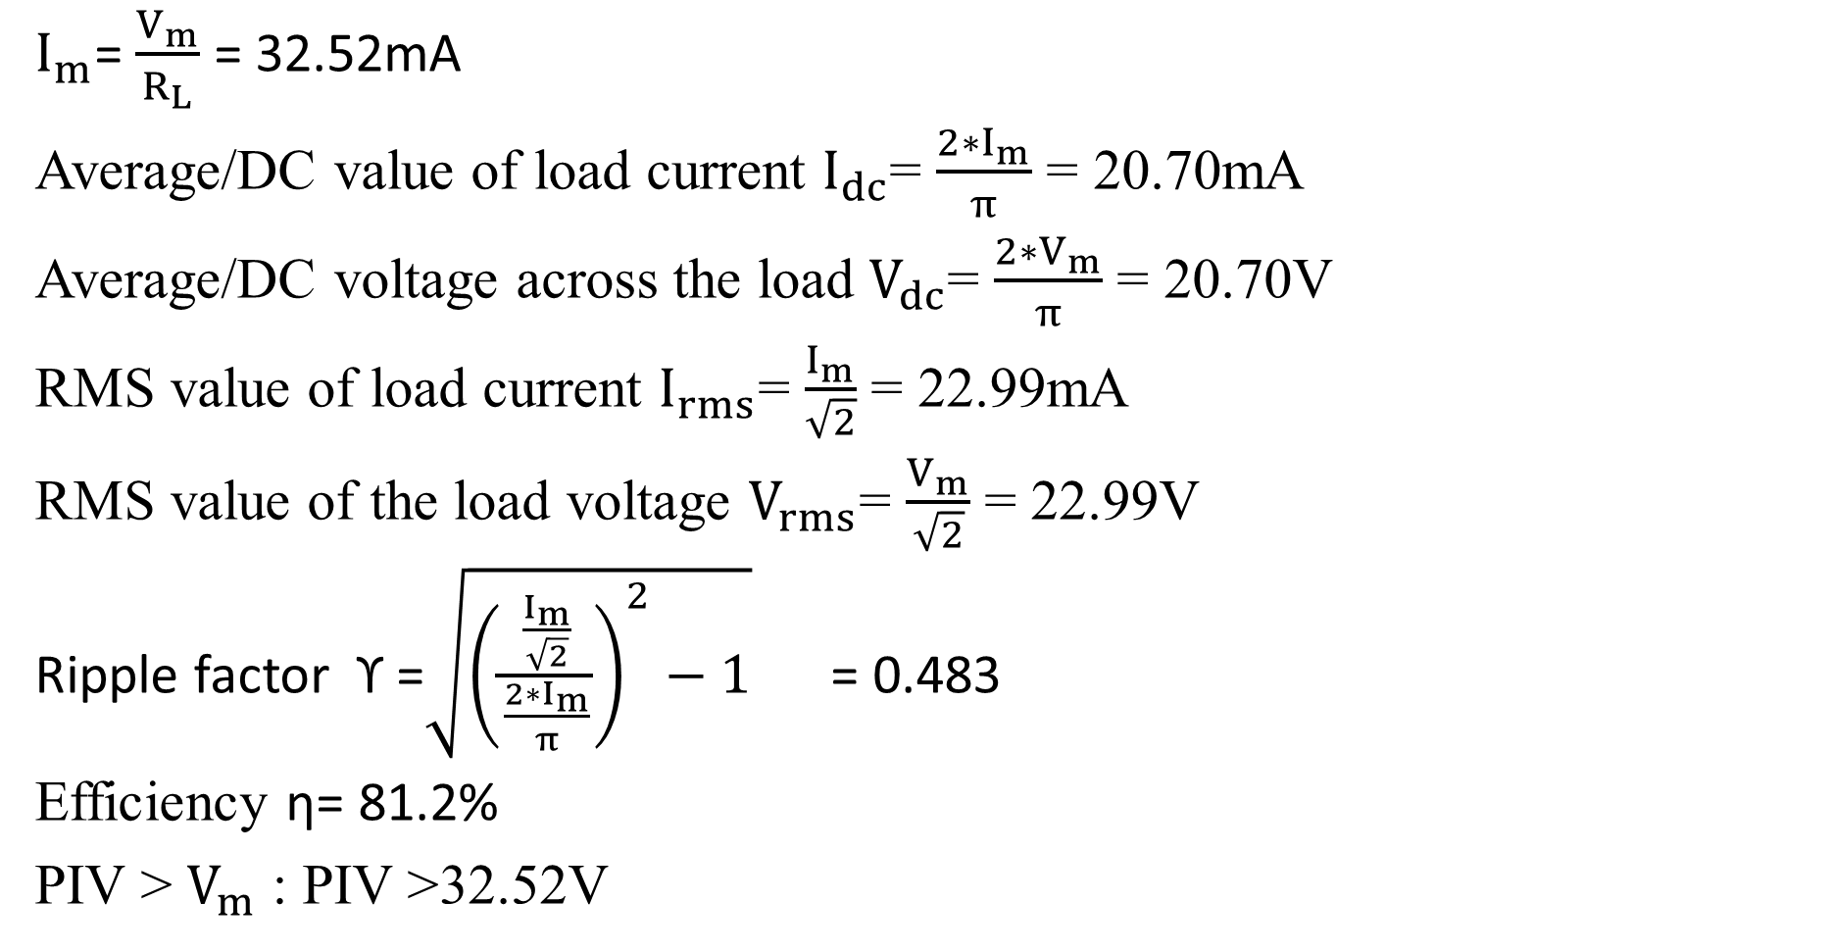
$I_{m}$= $\frac{V_{m}}{R_{L}}$ = 32.52mA
Average/DC value of load current $I_{dc}$= $\frac{2∗I_{m}}{π}$ = 20.70mA
Average/DC voltage across the load $V_{dc}$= $\frac{2∗V_{m}}{π}$ = 20.70V
RMS value of load current $I_{rms}$= $\frac{I_{m}}{\sqrt{2}}$ = 22.99mA
RMS value of the load voltage $V_{rms}$= $\frac{V_{m}}{\sqrt{2}}$ = 22.99V
Ripple factor ϒ =$\sqrt{{\left(\frac{\frac{I_{m}}{\sqrt{2}}}{\frac{2∗I_{m}}{π}}\right)}^{2}−1}$ = 0.483
Efficiency η= 81.2%
PIV > $V_{m}$ : PIV >32.52V

Slide 44

Exercise
An AC input of 150V,50Hz is applied to a transformer. Secondary of the transformer is connected to a Full Wave Rectifier with centre tap. Average load current is 84.39mA. Find the turns ratio of transformer if $R_{L}$= 200Ω

Slide 45
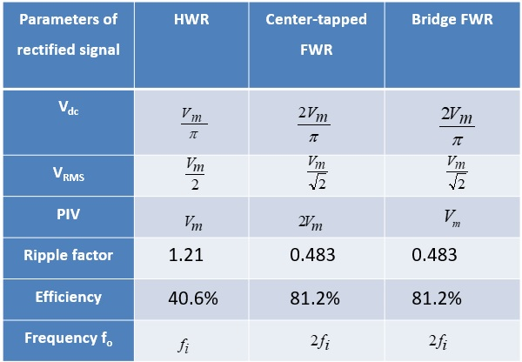
Comparison of rectifiers

Slide 46
Advantages of center tapped FWR over HWR
High Efficiency
low ripple factor
Disadvantages of center tapped FWR over HWR
Uses 2 diodes
Uses center tapped transformer
PIV rating is >2V_{m}

Slide 47
Activity
1. In HWR, the diode is forward biased for what duration of the time period?
(a) T/2 b) T/4 c) 3T/4 d) T
2. In center tapped FWR, each diode is forward biased for what duration of the time period?
(a) T/2 b) T/4 c) 3T/4 d) T
3. In a center tapped FWR , current through load resistor flows for what duration of the time period?
T/2 b) T/4 c) 3T/4 d) T
4. The ripple factor of FWR is greater than HWR
(a) True (b) False

Slide 48
Capacitor Filter
Commonly referred as C type filter
Key component of filter is the energy storing elements. Example: Capacitor
Capacitor helps to hold the output voltage to its maximum or peak value.
It can be used with HWR as well as with FWR

Slide 49
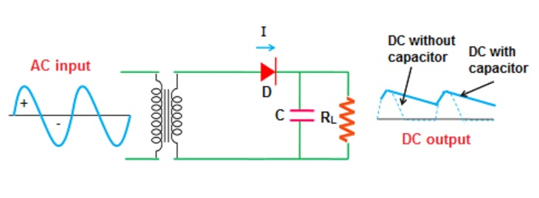
HWR with Capacitor Filter

Slide 50


HWR with Capacitor Filter Waveform
Capacitor is initially uncharged
During (0 to $\frac{π}{2}$) capacitor charges to V_{m}
During ($\frac{π}{2}$ to $π$)
Since capacitor retains charge, capacitor voltage > input voltage
Diode is now reverse biased.

Slide 51

Capacitor supplies current to the load and in this process, it slowly discharges through $R_{L}$
During ($π$ to $\frac{3π}{2}$) and ($\frac{3π}{2}$ to $2π$) capacitor continues to discharge.
During 5th quarter cycle, the input voltage begins to rise. When the input voltage just exceeds the capacitor voltage, diode starts to conduct. Capacitor again charges to V_{m}

Slide 52

Let $T_{1}$ be the discharging time of the capacitor and $T_{2}$ be the charging time.
Rate of charge/ discharge depends on the time constant $R_{L}$C
Larger the time constant, more time it takes to discharge.
Large $R_{L}$C is preferred to have a smoother output
Since charging time is less than discharging time, we can neglect $T_{2}$

Slide 53

Sawtooth approximation of output waveform

Slide 54

Let $I_{dc}$ be the average capacitor discharge current
Charge lost by the capacitor during $T_{1}$ , $Q_{dis}$= $I_{dc}$*$T_{1}$
Charge acquired by the capacitor during $T_{2}$ , $Q_{chg}$= $V_{rpp}$*C
Charge lost= Charge gained
$I_{dc}$*$T_{1}$= $V_{rpp}$*C
Since $T_{1}$ $≈$ $T$, ${ V}_{rpp}$= $\frac{I_{dc}∗T}{C}$ = $\frac{V_{dc}}{R_{L}∗C∗f}$ ----(1) T is the time period of input

Slide 55

Note: RMS value of a sawtooth waveform is related to its peak-peak value by the relation ${ V}_{r rms}$= $\frac{{ V}_{rpp}}{2\sqrt{3}}$
∴ $V_{rpp}$=${ V}_{r rms}$*$2\sqrt{3}$ -----(2)
Using equation (1) & (2)
Ripple factor ϒ= $\frac{{ V}_{r rms}}{V_{dc}}$ = $\frac{1}{2\sqrt{3}∗fCR_{L}}$
Larger the $R_{L}$C, lesser is the ripple factor and as result smoother output

Slide 56

From the sawtooth approx wave,
$V_{dc}$= $V_{m}$- $\frac{V_{rpp}}{2}$
=$V_{m}$- $\frac{V_{dc}}{2∗R_{L}∗C∗f}$
Upon re-arranging,
$V_{dc}$= $V_{m}\left(\frac{2∗{fCR}_{L}}{1+2∗{fCR}_{L}}\right)$

Slide 57

FWR with Capacitor Filter

Slide 58

Full Wave Bridge Rectifier with Capacitor Filter

Slide 59

Sawtooth approximation of output waveform

Slide 60

$T_{1}$ $≈$ $\frac{T}{2}$ = $\frac{1}{2f}$
$V_{rpp}$= $\frac{V_{dc}}{2∗R_{L}∗C∗f}$
Ripple factor ϒ= $\frac{{ V}_{r rms}}{V_{dc}}$ = $\frac{1}{4\sqrt{3}∗fCR_{L}}$
$V_{dc}$= $V_{m}\left(\frac{4∗{fCR}_{L}}{1+4∗{fCR}_{L}}\right)$
Derivation : Exercise

Slide 61

Q6. A HWR with capacitor filter is supplied from a transformer having a peak secondary voltage of 20V @ 50Hz. If $R_{L}$=560Ω and C=100µF, calculate the ripple factor and average voltage across the load.
ϒ= $\frac{1}{2\sqrt{3}∗fCR_{L}}$ = 0.103
$V_{dc}$= $V_{m}\left(\frac{2∗{fCR}_{L}}{1+2∗{fCR}_{L}}\right)$ = 16.96V
Activity: Compare the result with that of a HWR without filter

Slide 62

Q7. A HWR with capacitor filter has to supply an average voltage of 30V to a 900Ω load. Find the RMS input voltage and capacitance required to limit the ripple factor at 0.05. Assume frequency=50Hz.
ϒ= $\frac{1}{2\sqrt{3}∗fCR_{L}}$ = 0.05
→ C= 128.3µF
$V_{dc}$= $V_{m}\left(\frac{2∗{fCR}_{L}}{1+2∗{fCR}_{L}}\right)$ = 30V
→ $V_{m}$=32.6V
→ RMS input voltage =$\frac{32.6}{\sqrt{2}}$ = 23.05V
Activity: Repeat for FWBR with capacitor filter

Slide 63

Q8. A HWR with capacitor filter is fed from a transformer having turns ratio 6:1. Primary voltage is 110V@60Hz. Expected ripple factor ≤ 0.03 and average load current 500mA. Calculate the value of capacitance.
Turns ratio= 6:1
→ Secondary RMS voltage= 18.33V
→$V_{m}$= 25.93V
ϒ= $\frac{1}{2\sqrt{3}∗fCR_{L}}$ = 0.03 → $fCR_{L}$=9.62
$V_{dc}$= $V_{m}\left(\frac{2∗{fCR}_{L}}{1+2∗{fCR}_{L}}\right)$ = 24.65V
$V_{dc}$= $I_{dc}$*$R_{L}$ → $R_{L}$= 49.3Ω
C= 3.25mF

Slide 64

Q9. A particular load has to be supplied with 10mA average current at 5V dc with ϒ≤ 0.2%. Find the value of C required to be connected across the load of FWBR. Also find the turns ratio if primary voltage is 220V@50Hz
$R_{L}$= $\frac{V_{dc}}{I_{dc}}$ = 500Ω
ϒ= $\frac{1}{4\sqrt{3}∗fCR_{L}}$ → C=2.88mF
$V_{dc}$= $V_{m}\left(\frac{4∗{fCR}_{L}}{1+4∗{fCR}_{L}}\right)$ → $V_{m}$= 5.01V
RMS voltage at the input of rectifier= $\frac{5.01}{\sqrt{2}}$ = 3.55V
$\frac{N_{1}}{N_{2}}$ = $\frac{V_{1}}{V_{2}}$ → $\frac{N_{1}}{1}$ = $\frac{220}{3.55}$
Required turns ratio = 62:1

Slide 65
Activity: Repeat Q9 for FWR with capacitor filter

